Slide 1
WebQuiz Prototype
Work in progress…
Green arrows indicate where you should click to continue with the prototype. If there are more than one arrows then you can click either.

Slide 2
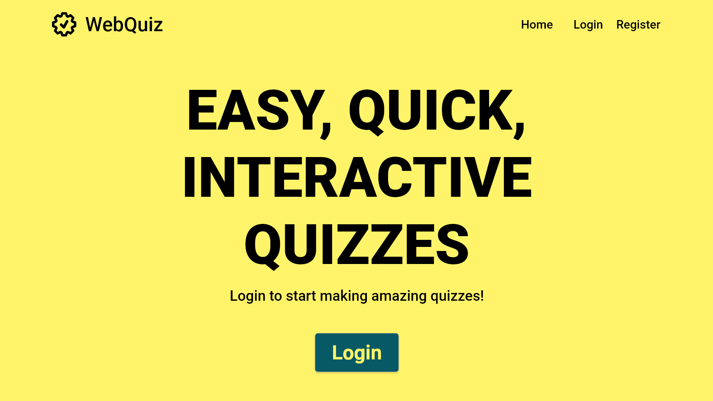
If the Quiz Maintainer does not have an account, one can be registered here

Slide 3
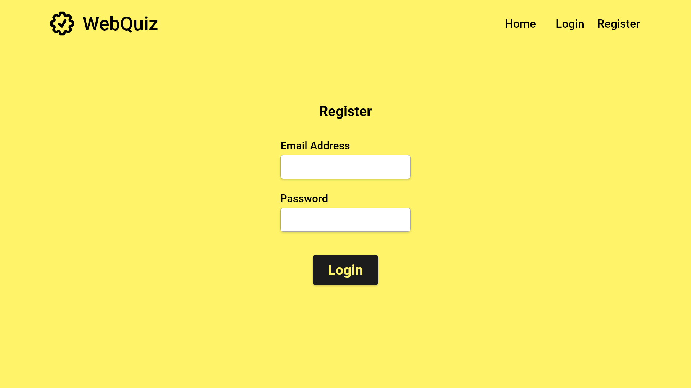
User fills in both text boxes
Click the button once forms are filled

Slide 4
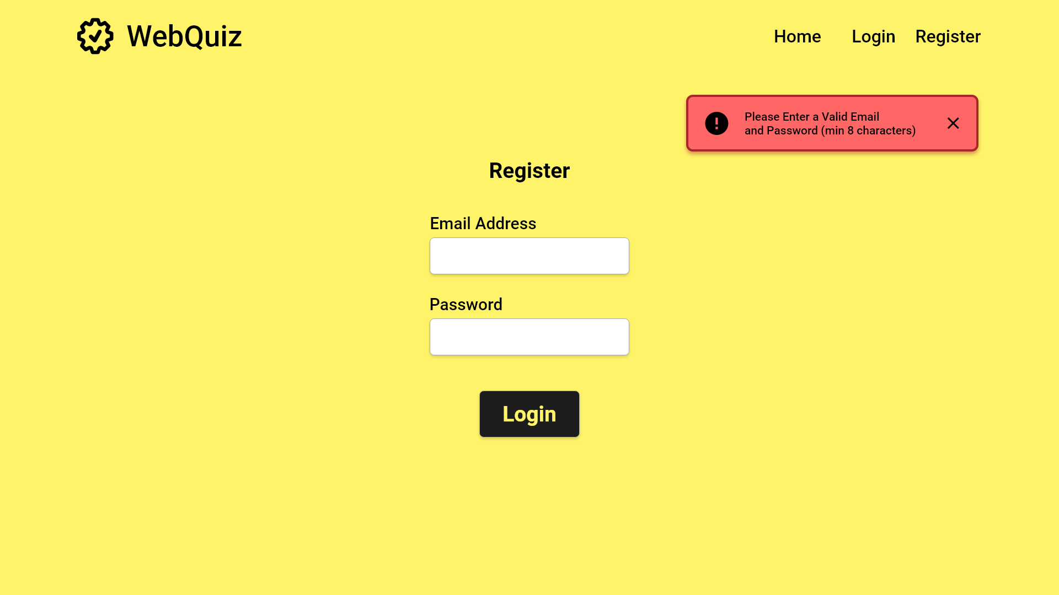
An error message will be returned if either box is left blank
User fills in both text boxes
Click the button once forms are filled

Slide 5
xyz@aber.ac.uk
***********

Slide 7
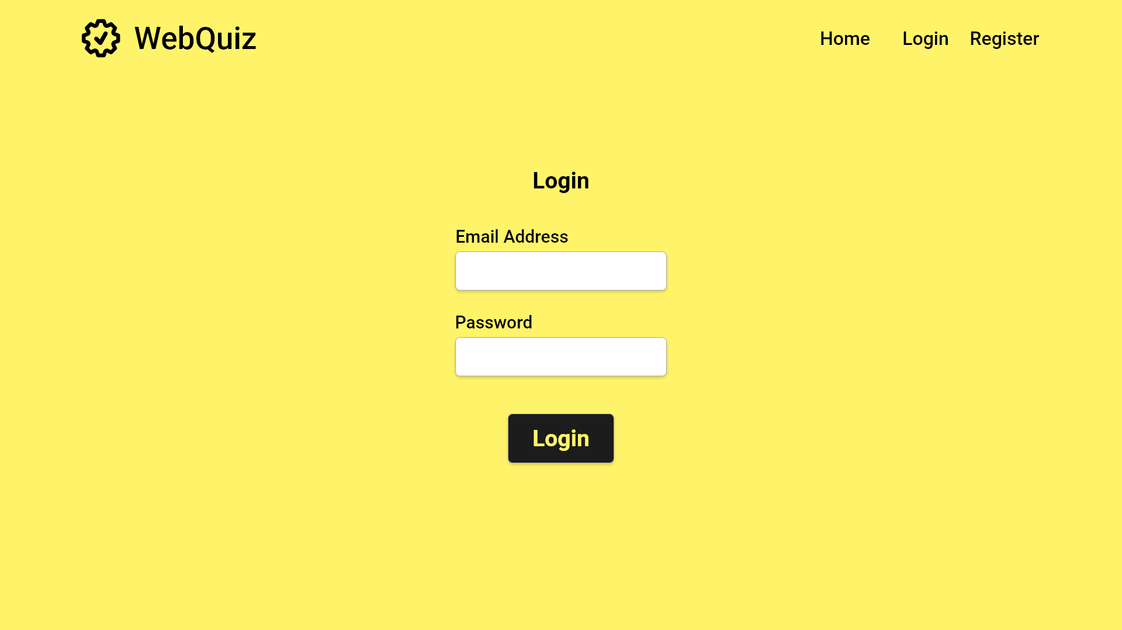

Slide 8
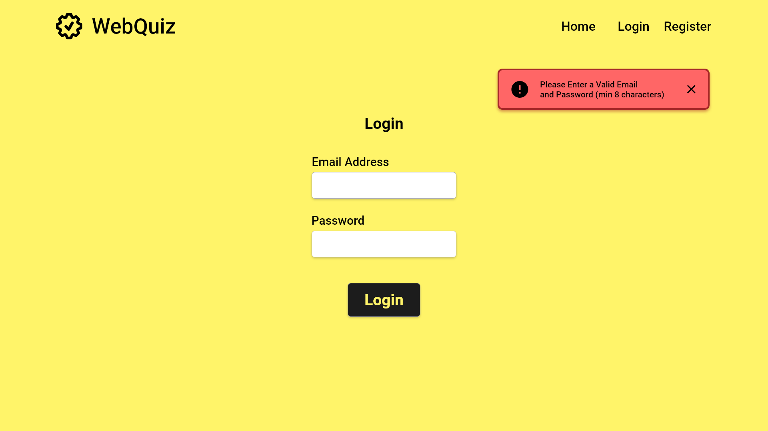
An error message will be returned if an invalid email address is provided
fakeemail@gmail.com
***********

Slide 9
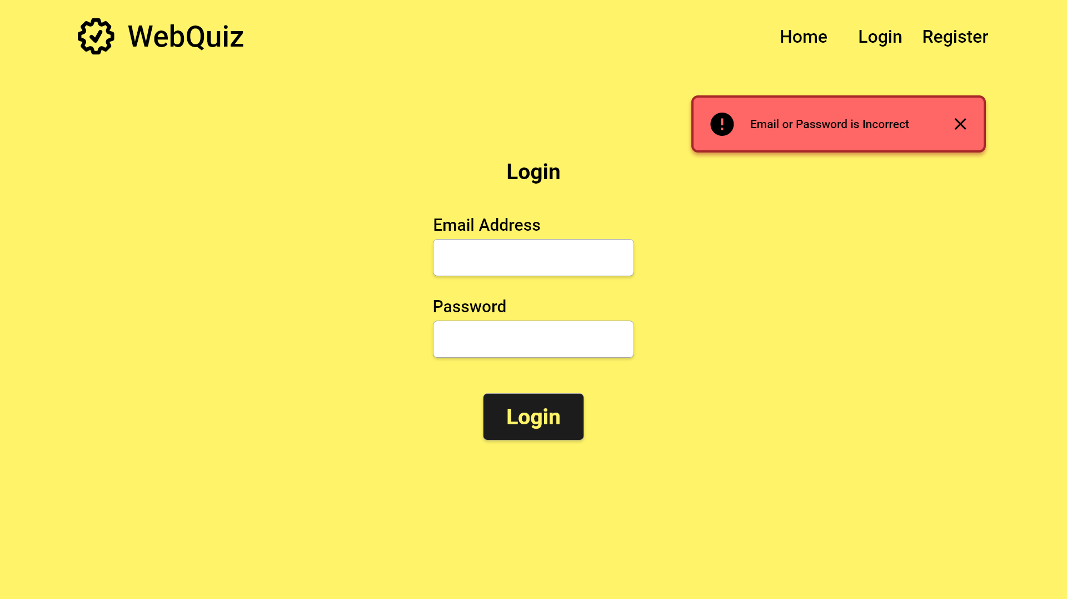
An error message will be returned if the provided details are incorrect

Slide 10
xyz@aber.ac.uk
***********

Slide 11
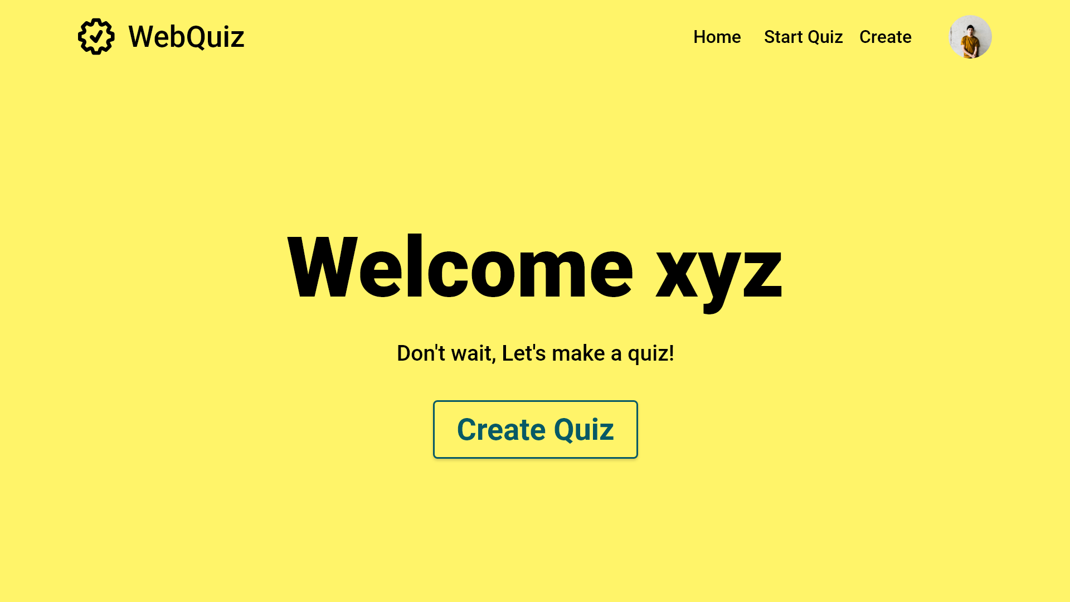
Splash screen containing username. Transitions after a couple of seconds
FR1: The Quiz Maintainer is able to create an empty quiz on this page

Slide 12
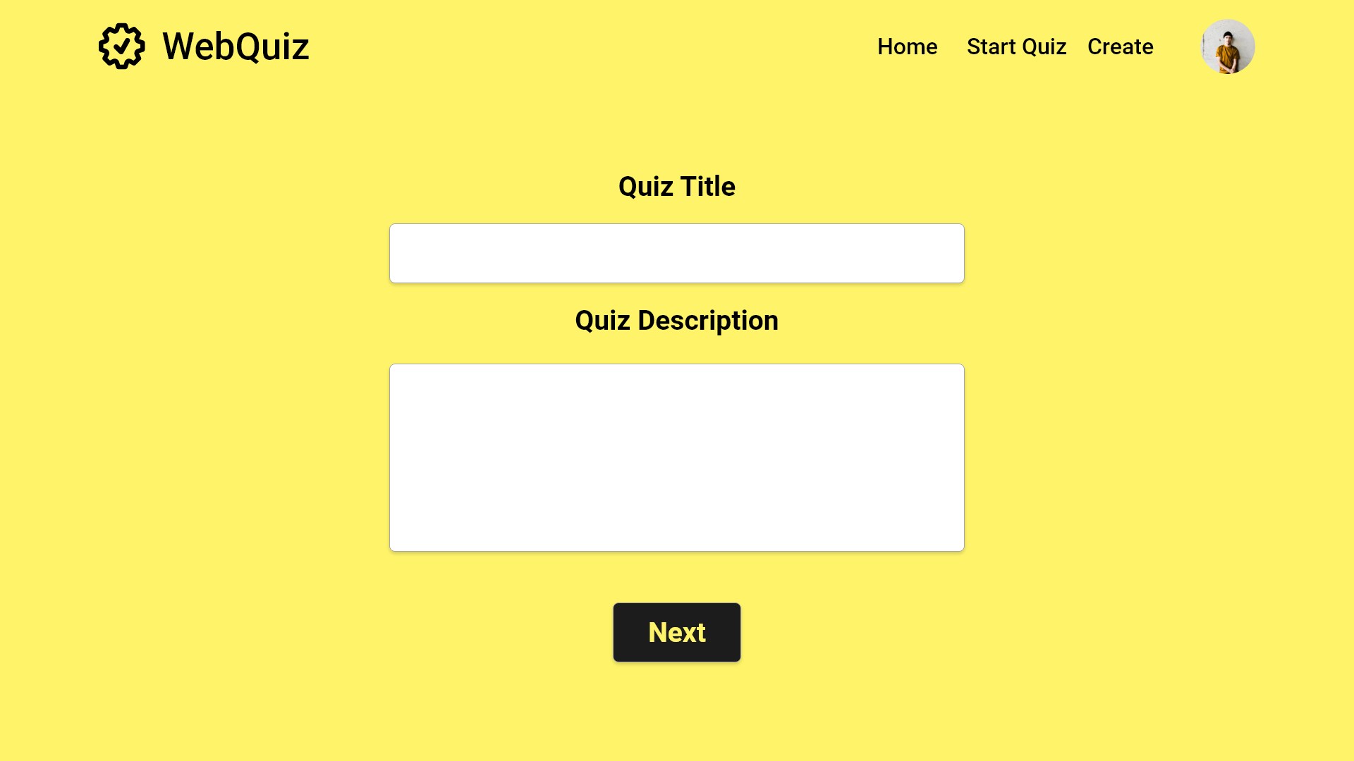
FR1: A quiz title and introductory text can be set here

Slide 13
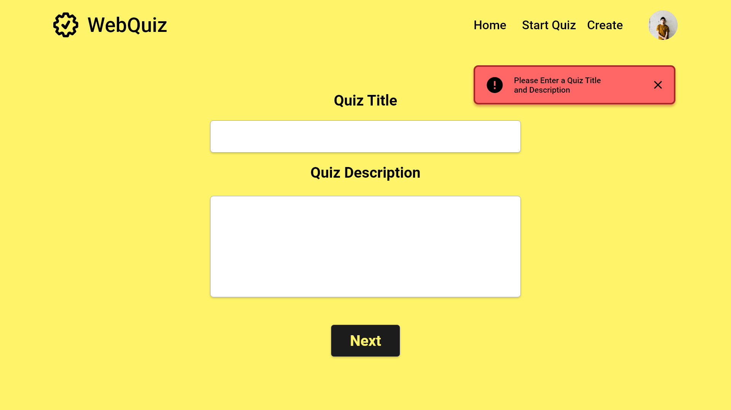
FR1: A quiz title and introductory text can be set here
An error message will be returned if either box is left blank

Slide 14
French Language 13
FR1: A quiz title and introductory text can be set here
This Quiz utilizes multiple choice and True or False questions.

Slide 15
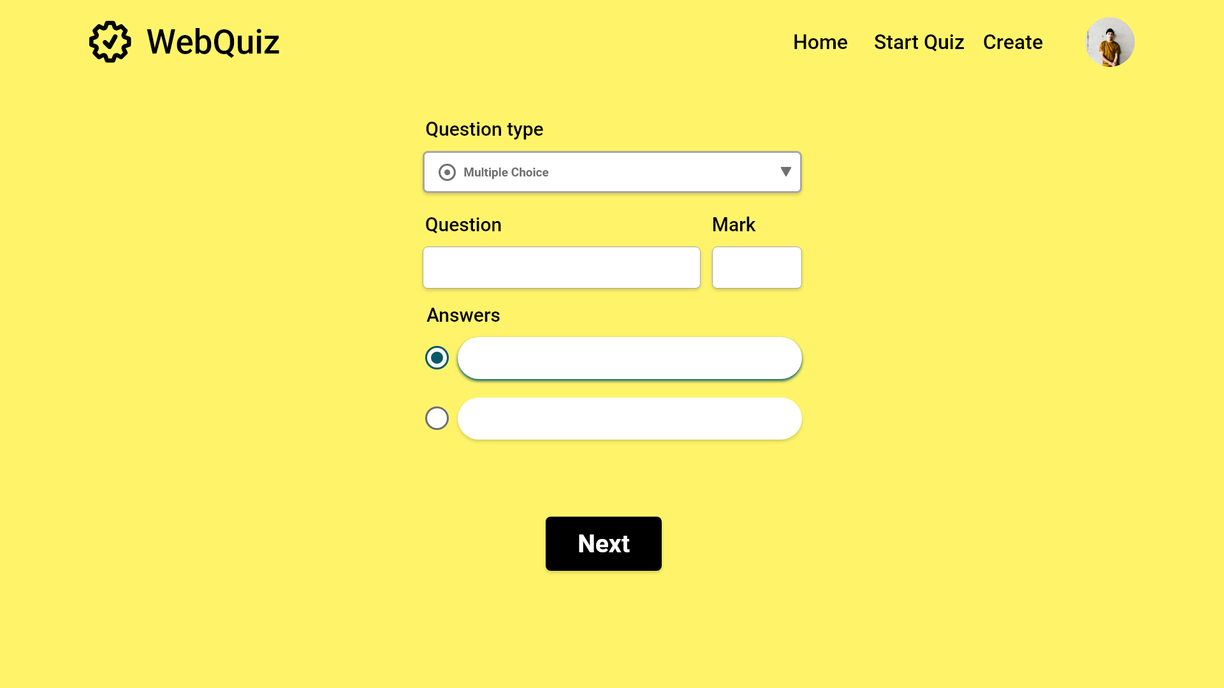

FR2: The Quiz Maintainer can add multiple choice questions to a quiz
FR2: Each question has a mark value, defaulted to 0
0
FR2: Minimum of two possible answers; correct answers are checked

Slide 16
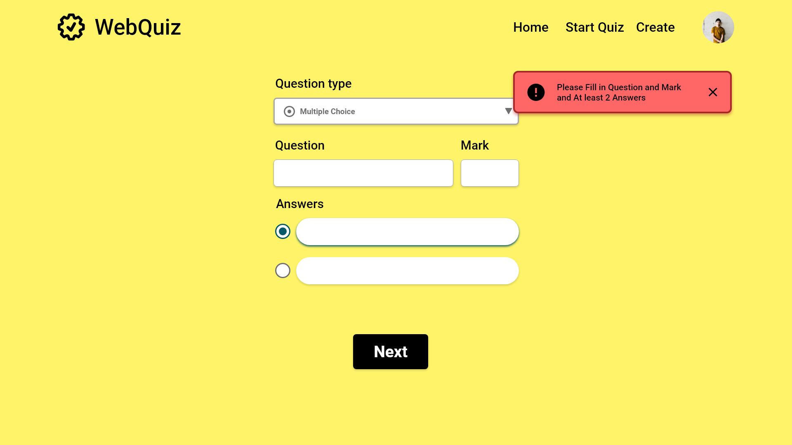
FR2: The Quiz Maintainer can add multiple choice questions to a quiz
FR2: Each question has a mark value, defaulted to 0
0
FR2: Minimum of two possible answers; correct answers are checked

Slide 17
FR2: The Quiz Maintainer can add multiple choice questions to a quiz
What is cat in French?
1
0
FR2: Minimum of two possible answers; correct answers are checked
Chien

Slide 18
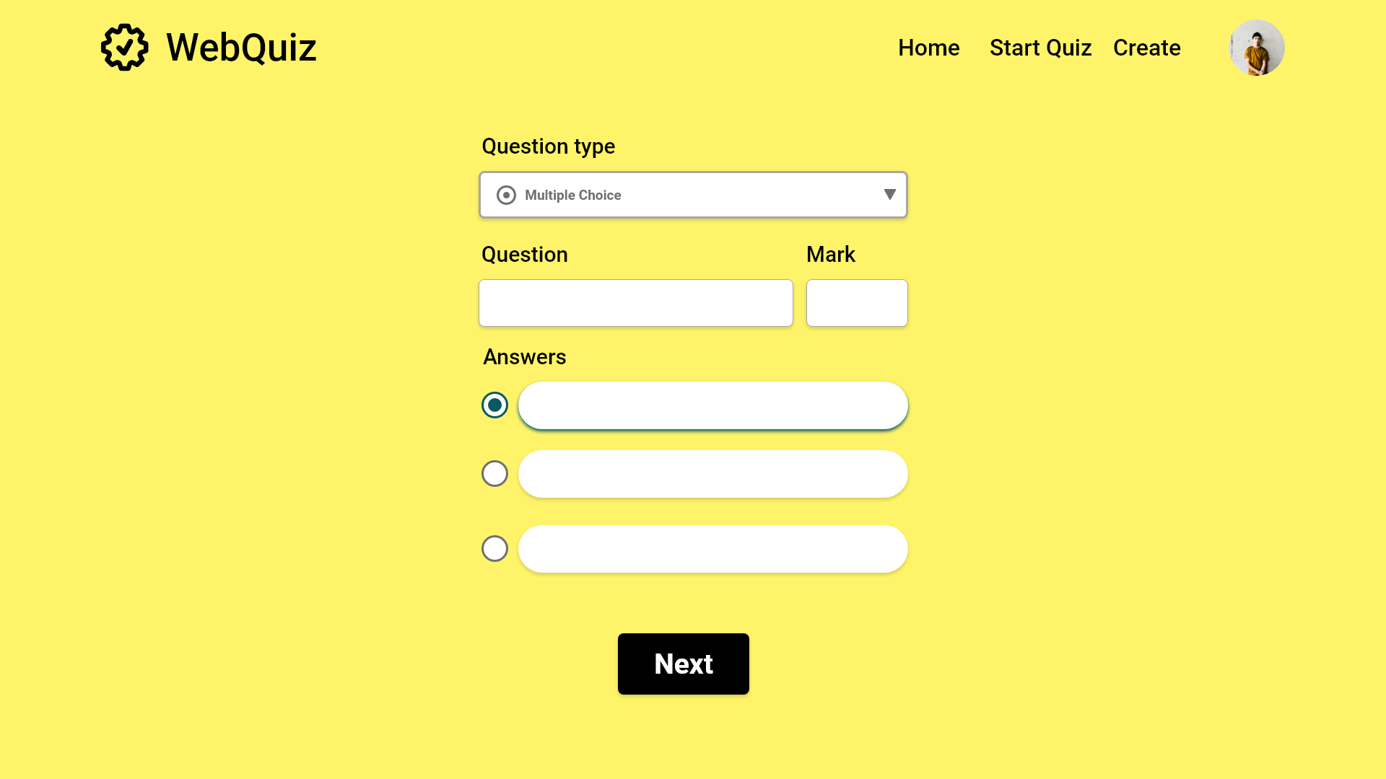
FR2: The Quiz Maintainer can add multiple choice questions to a quiz
What is cat in French?
10
FR2: Minimum of two possible answers; correct answers are checked
Chien
Chat
FR2: Additional answer options are presented as needed

Slide 19
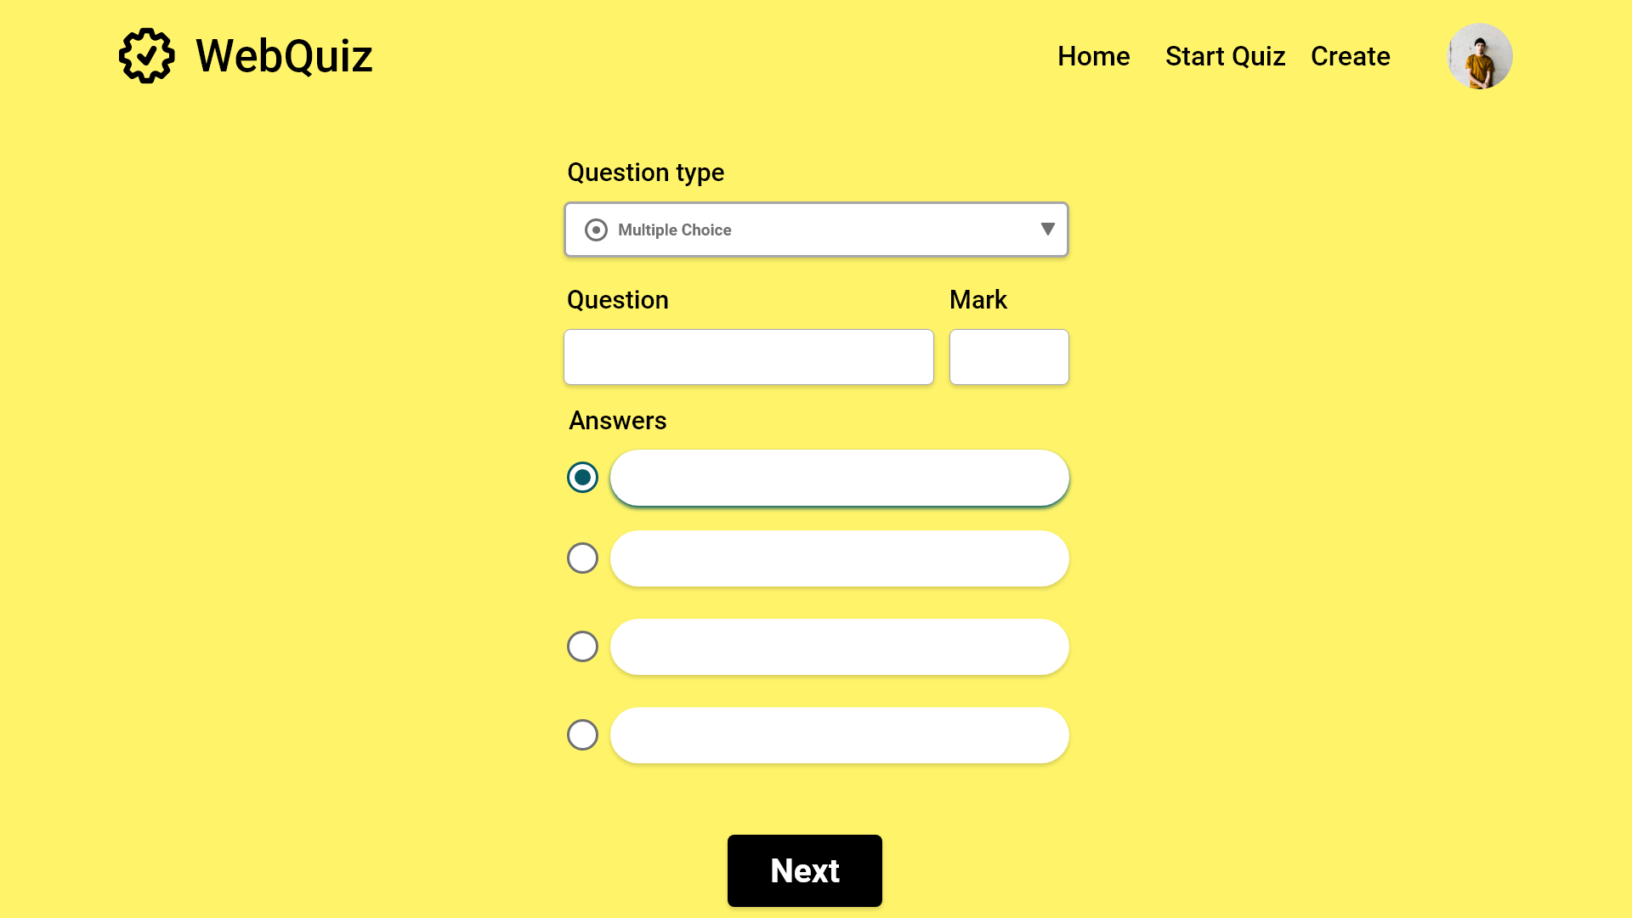
FR2: The Quiz Maintainer can add multiple choice questions to a quiz
What is cat in French?
10
FR2: Minimum of two possible answers; correct answers are checked
Chien
Chat
FR2: Additional answer options are presented as needed
Cheval
Fille

Slide 20
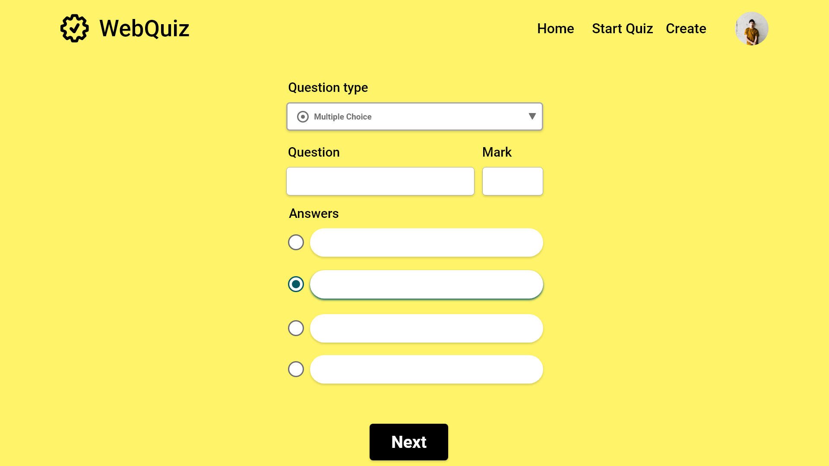
FR2: The Quiz Maintainer can add multiple choice questions to a quiz
What is cat in French?
10
FR2: Minimum of two possible answers; correct answers are checked
Chien
Chat
FR6: Quiz Maintainer can edit questions at any point
Cheval
Fille

Slide 21
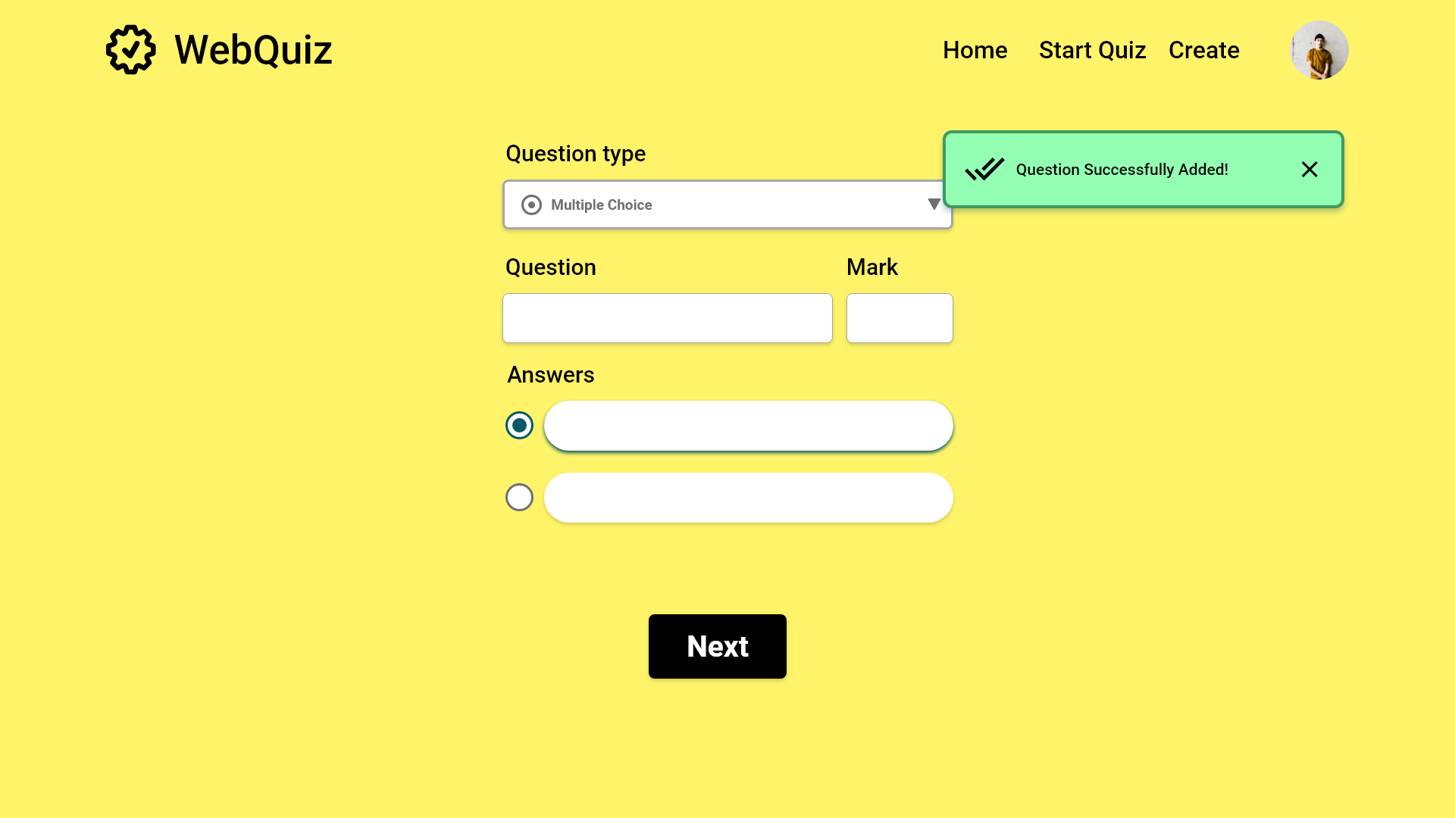

0
FR6: Quiz Maintainer can jump between questions to edit

Slide 22
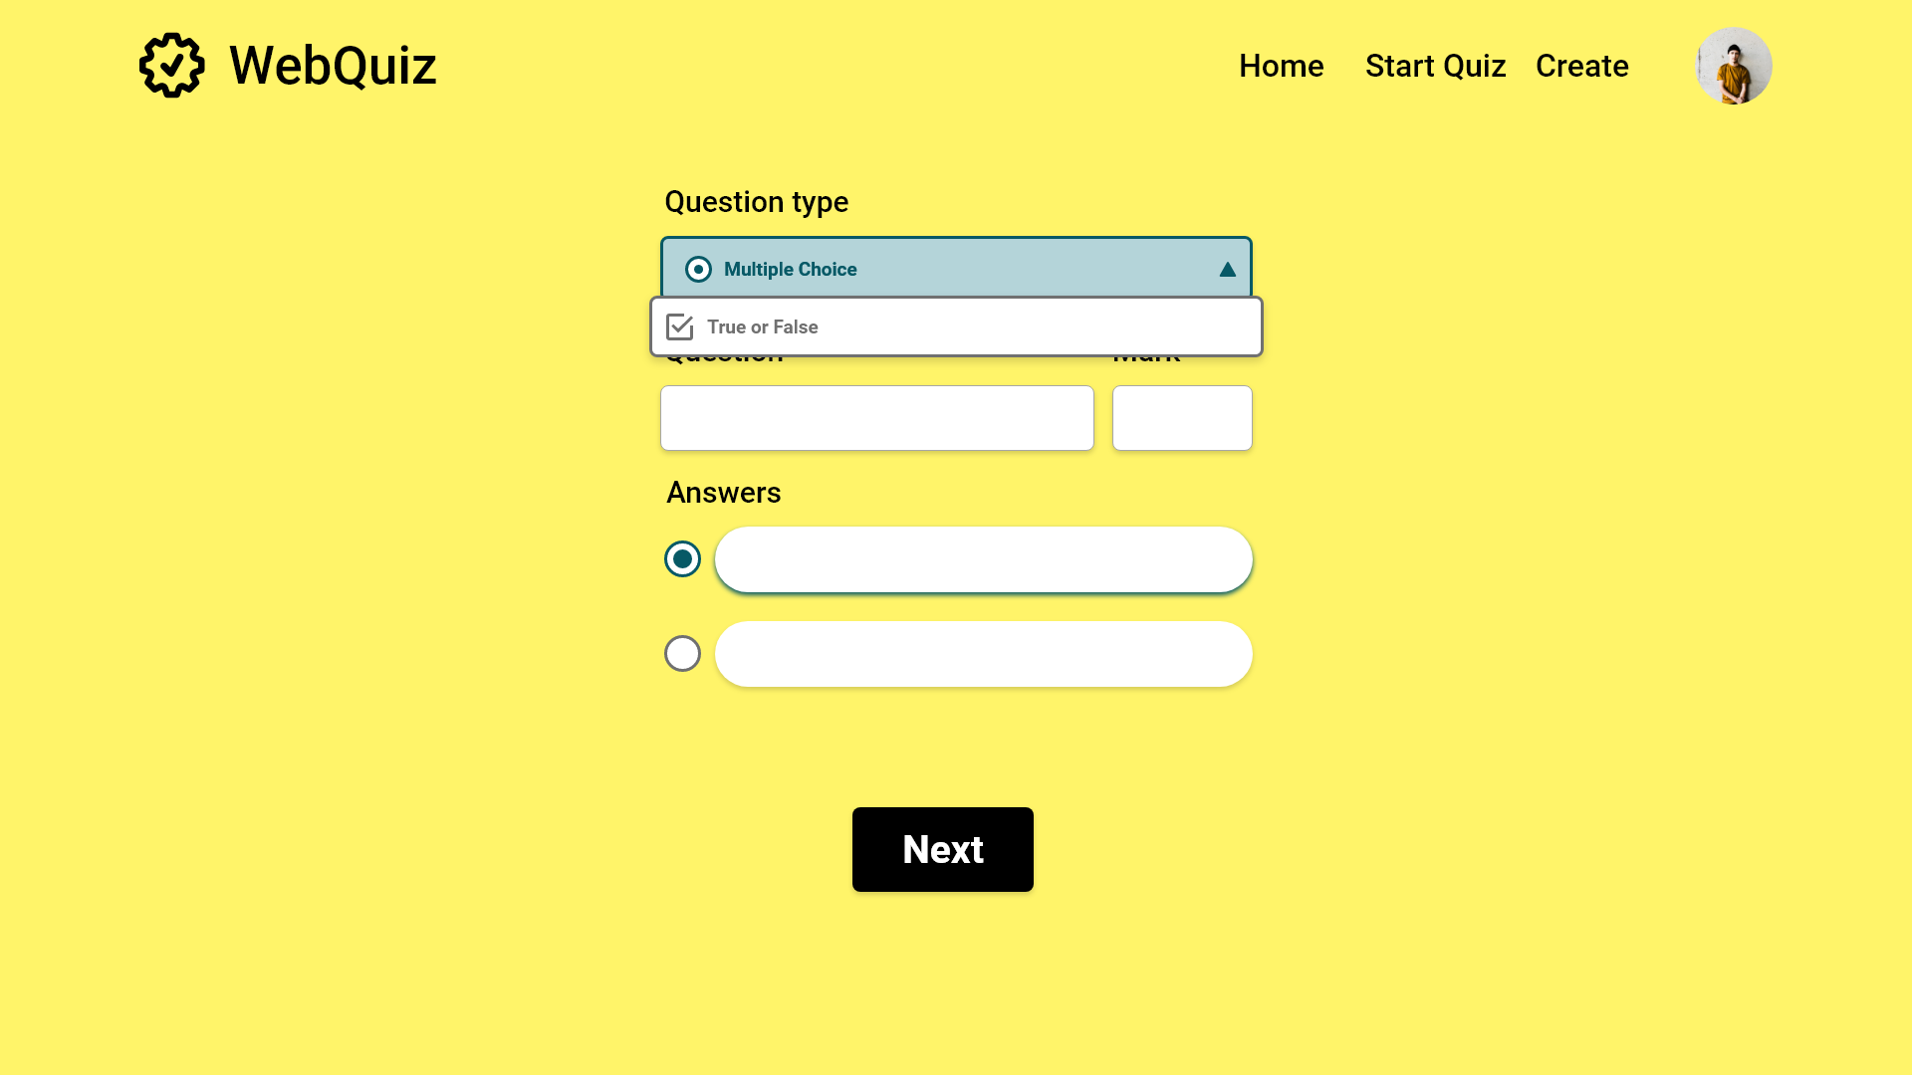
0

Slide 23
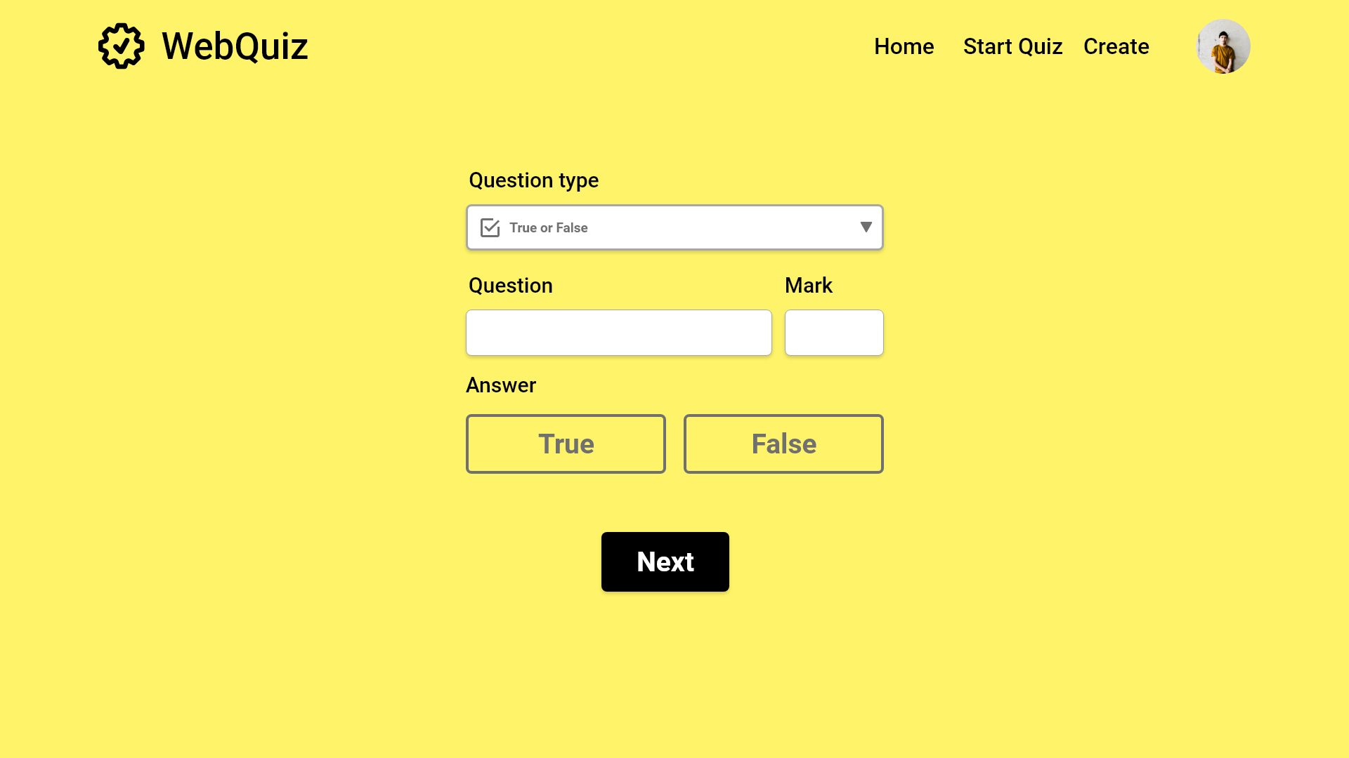
FR3: The Quiz Maintainer can add true or false questions to a quiz
FR3: Question is set the same as before
FR3: The default mark is 0 again
0
FR3: The Quiz Maintainer selects whether question is true or false

Slide 24
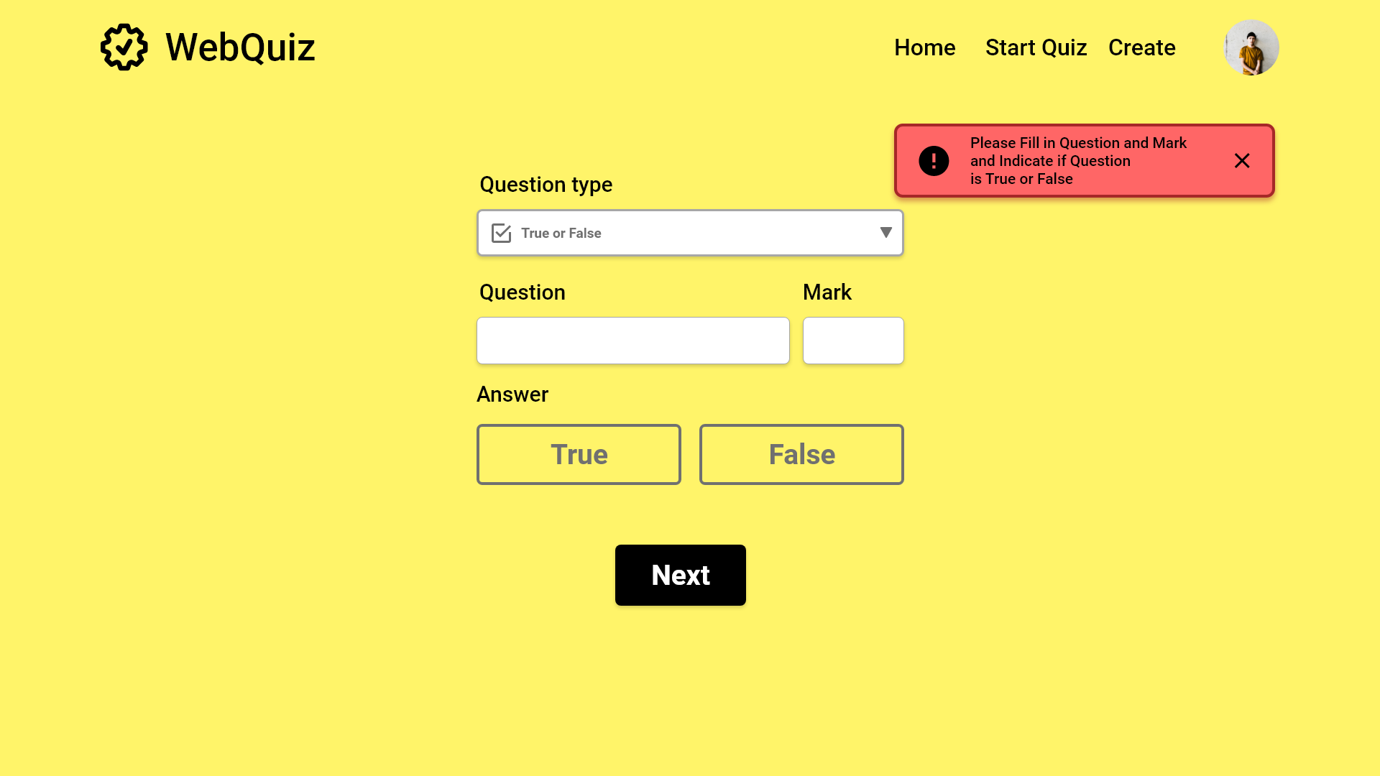
FR3: The Quiz Maintainer can add true or false questions to a quiz
FR3: Question is set the same as before
FR3: The default mark is 0 again
0
FR3: The Quiz Maintainer selects whether question is true or false

Slide 25
FR3: The Quiz Maintainer can add true or false questions to a quiz
FR3: Question is set the same as before
Poisson is french for dog
0
10
FR3: The Quiz Maintainer selects whether question is true or false

Slide 26
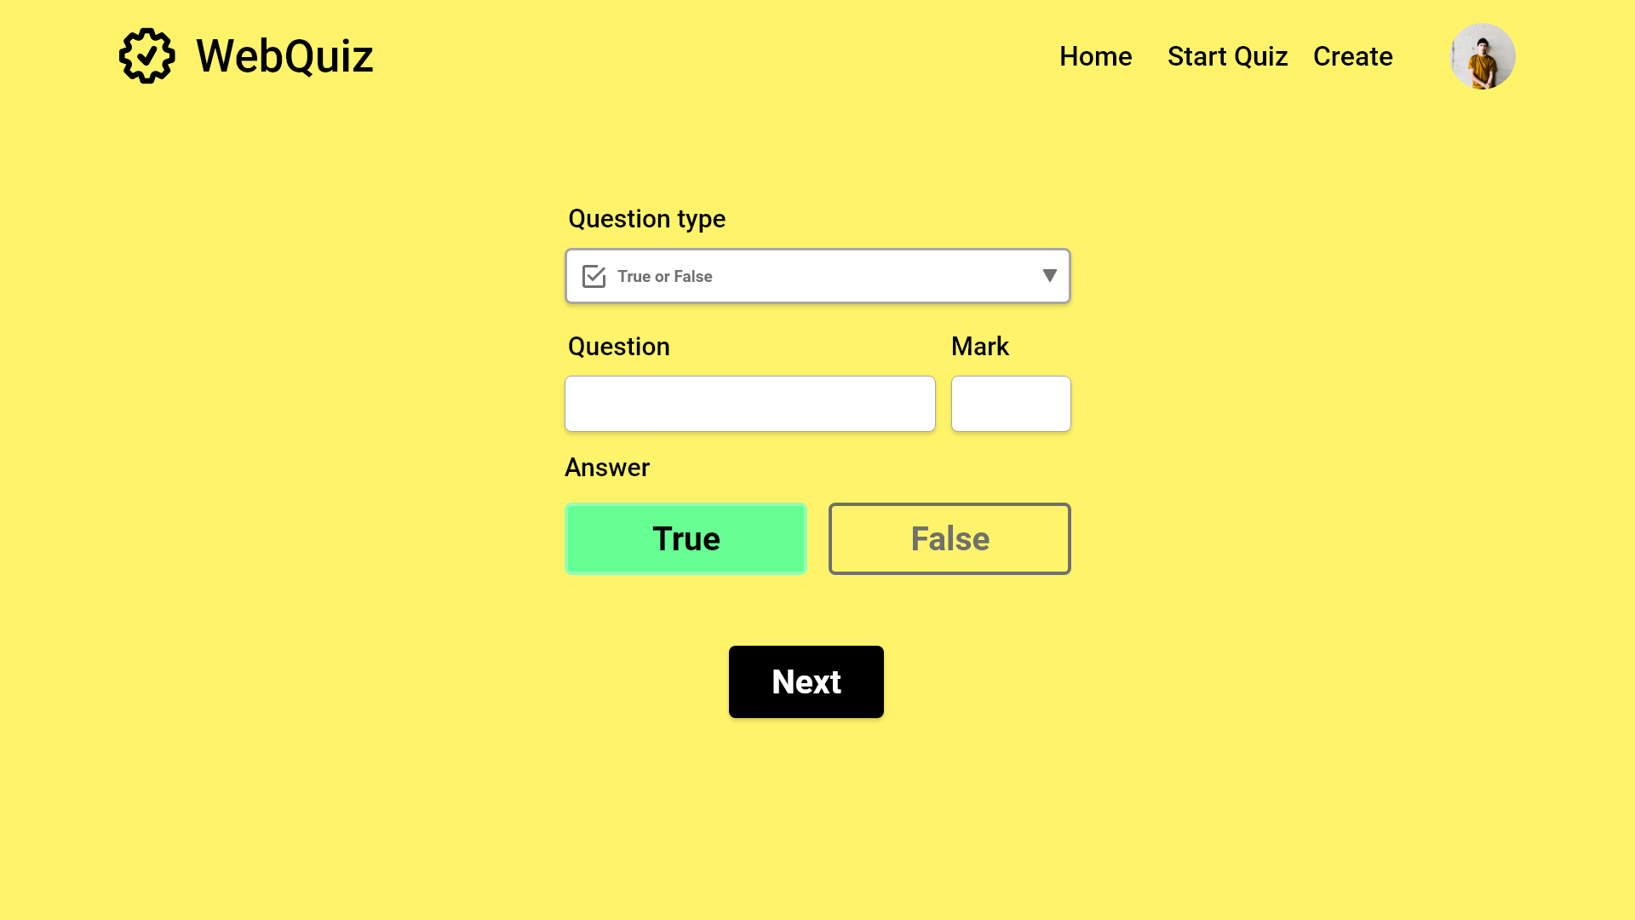
FR3: The Quiz Maintainer can add true or false questions to a quiz
FR3: Question is set the same as before
Poisson is french for dog
10
FR3: The Quiz Maintainer selects whether question is true or false

Slide 27
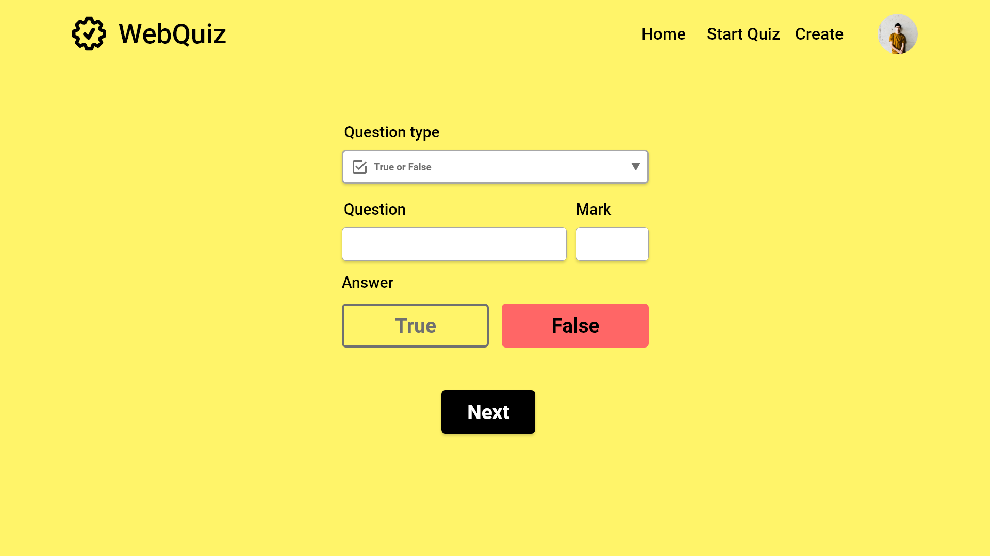
FR3: The Quiz Maintainer can add true or false questions to a quiz
FR3: Question is set the same as before
Poisson is french for dog
10
FR3: The Quiz Maintainer selects whether question is true or false

Slide 28
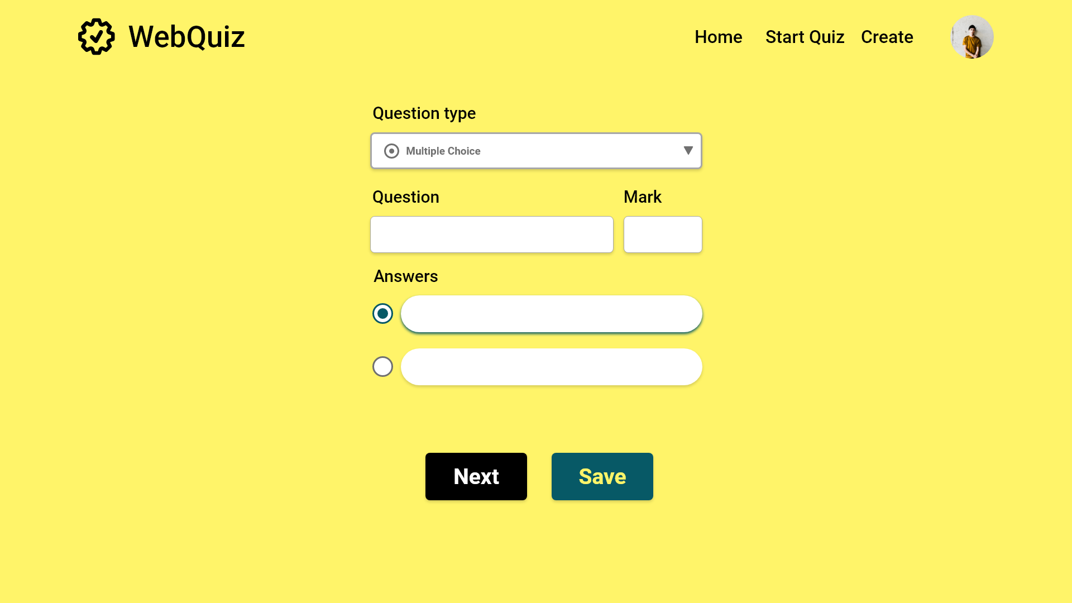

FR2: Quiz Maintainer can jump between questions

Slide 29
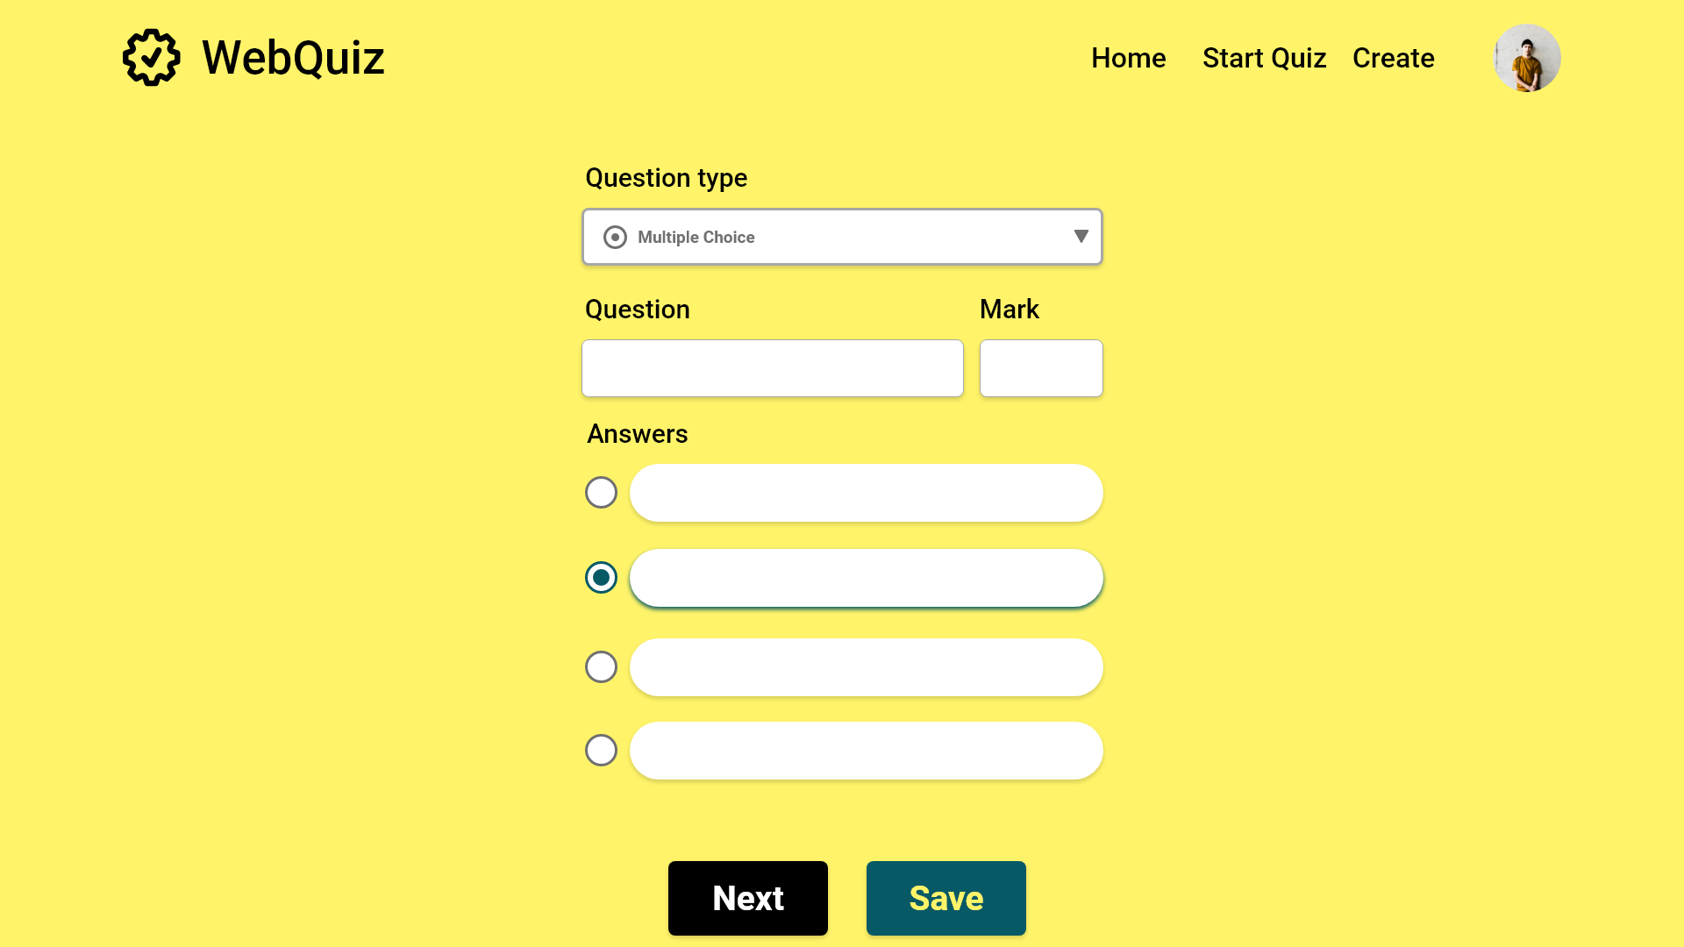
What is cat in French?
10
Chien
Chat
User can scroll down to view Pagination if it is out of view
Cheval
Fille

Slide 30

What is cat in French?
10
Chien
Chat
Cheval
Fille

Slide 31
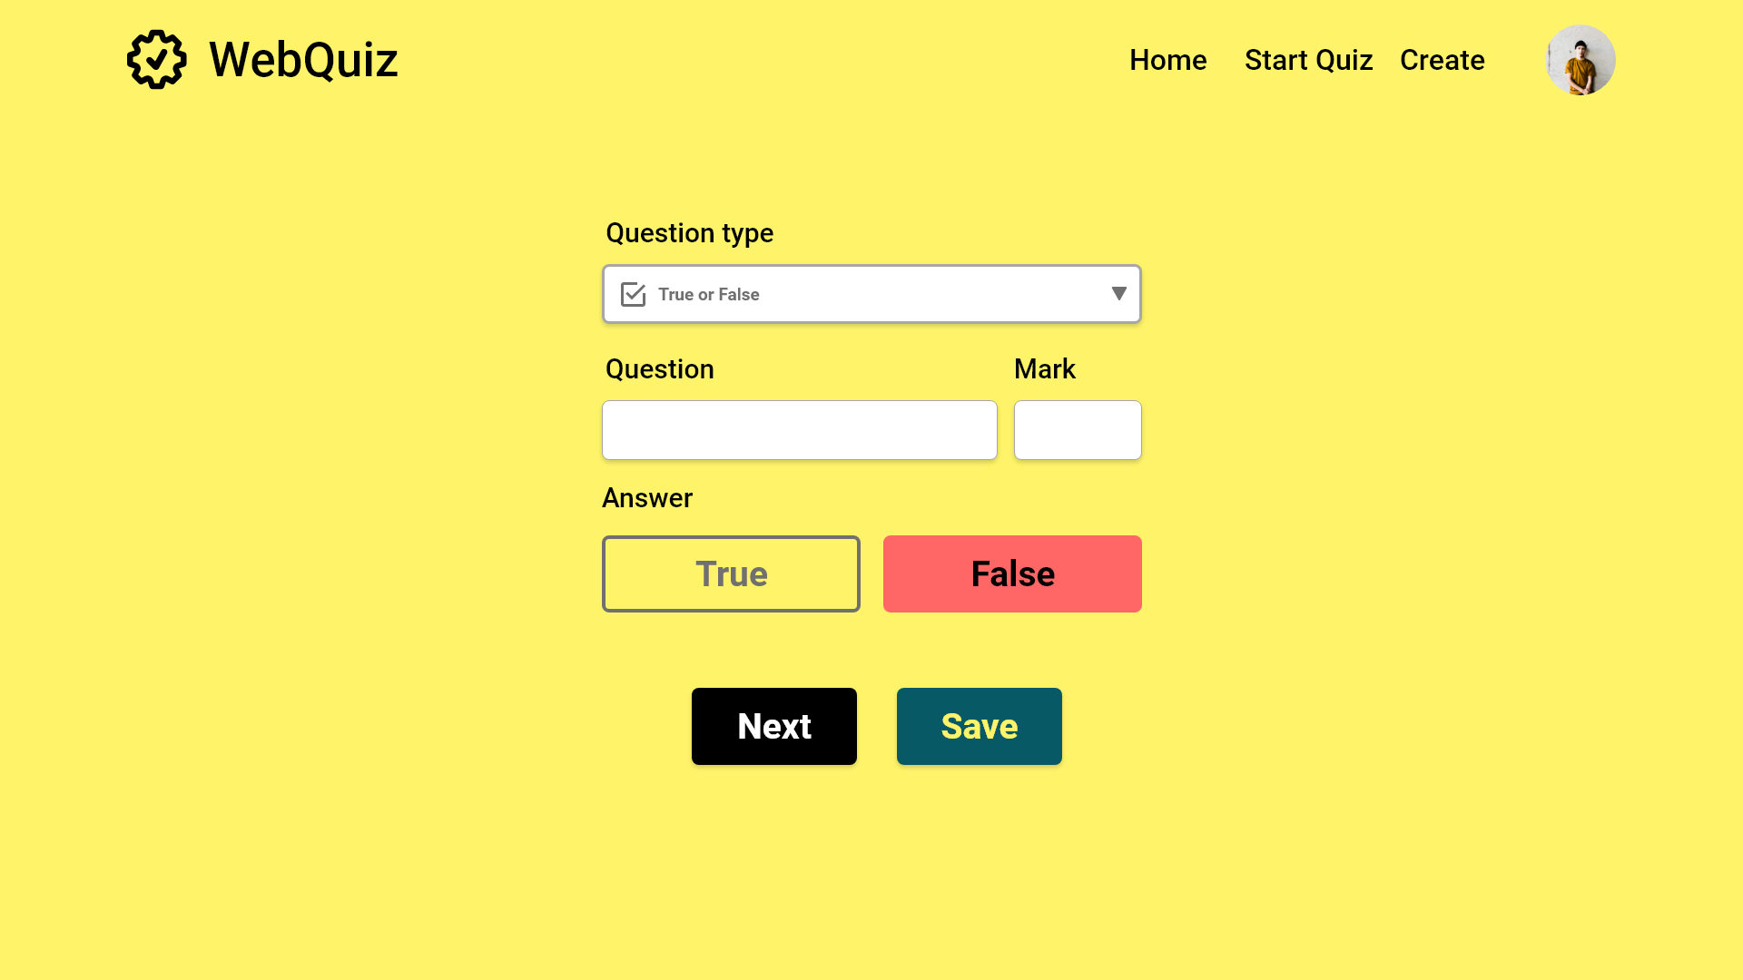

Poisson is french for dog
10
Once all questions have been set the, the quiz is saved when the Quiz Maintainer clicks ‘Save’

Slide 32
Quiz Maintainer is returned to the splash screen

